Slide 1
Welcome Let’s get acquainted

Slide 2
Agenda
9h00-9h15 Intro + Portail Azure
9h15-10h00 Web Apps
10h00-10h30 Azure Storage
10h30-10h45 PAUSE
10h45-12h00 Les Fonctions Azure
12h00-12h30 LUNCH
12h30-13h15 Microsoft Cognitive Services
13h15-14h00 DocumentDB
14h00-14h15 PAUSE
14h15-15h00 Monitoring avec App Insights
15h00-16h00 DevOps

Slide 3
Agenda
9h00-9h15 Intro + Portail Azure Introduction de la journée et intro au portail Alexandre Brisebois, Microsoft

Slide 4
Agenda
9h15-10h00 Web Apps Création et déploiement d’un site Web avec Visual Studio. Survol des paramètres et options dans Visual Studio et dans le portail Azure. Vivien Chevallier

Slide 5
Agenda
10h00-10h30 Azure Storage Exploration du Azure Storage et sauvegarde d'un message dans le Storage Queue. Utilisation du tooling de Visual Studio. Alexandre Brisebois, Microsoft

Slide 6
Agenda
10h30-10h45 PAUSE
10h45-12h00 Les Fonctions Azure Le "serverless computing" est populaire ces temps-ci et vous verez comment créer une fonction Azure dont le déclencheur sera l'ajout du message dans une Storage Queue. Vincent Biret

Slide 7
Agenda
12h00-12h30 LUNCH 12h30-13h15 Microsoft Cognitive Services Vous verrez comment analyser un texte en utilisant le Sentiment Analysis API afin d'en extraire son sentiment (positif ou négatif) ainsi que la langue utilisée. Guy Barrette. MVP Azure
Notes:
pizza all dressed et végé, gracieuseté de Microsoft

Slide 8
Agenda
13h15-14h00 DocumentDB Vous connaissez les bases de données relationnelles comme SQL Server mais connaissez vous celles qui sont NoSQL? Vous verrez comment sauvegarder les données receuillies dans la base de données DocumentDB. David Chapdelaine, Microsoft

Slide 9
Agenda
14h00-14h15 PAUSE
14h15-15h00 Monitoring avec App Insights Une fois déployé, il est important de bien faire le monitoring de notre application. Application Insights est un service permettant d'instrumenter les applications Web afin d'en de monitorer la performance et l'utilisation. Samir Bellouti, Sabbel Conseils

Slide 10
Agenda
15h00-16h00 DevOps DevOps ça vous dis de quoi ? Vous verrez comment scripter votre environnment afin de le recréer facilement via script et template ARM. Stéphane Lapointe, GSOFT, MVP Azure

Slide 11
Step 0 Intro + Portail Azure
Alexandre Brisebois
Technical Solutions Professional, Azure
http://alexandrebrisebois.wordpress.com

Slide 12
Goal
Getting to know Azure and the Portal

Slide 13
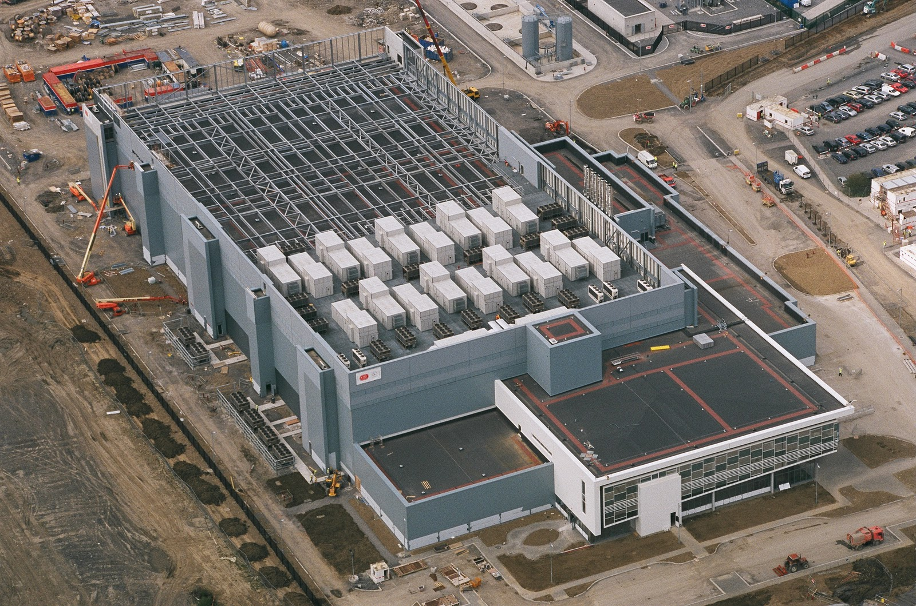
Notes:
This is what we think of when we hear the word “Datacenter”

Slide 14
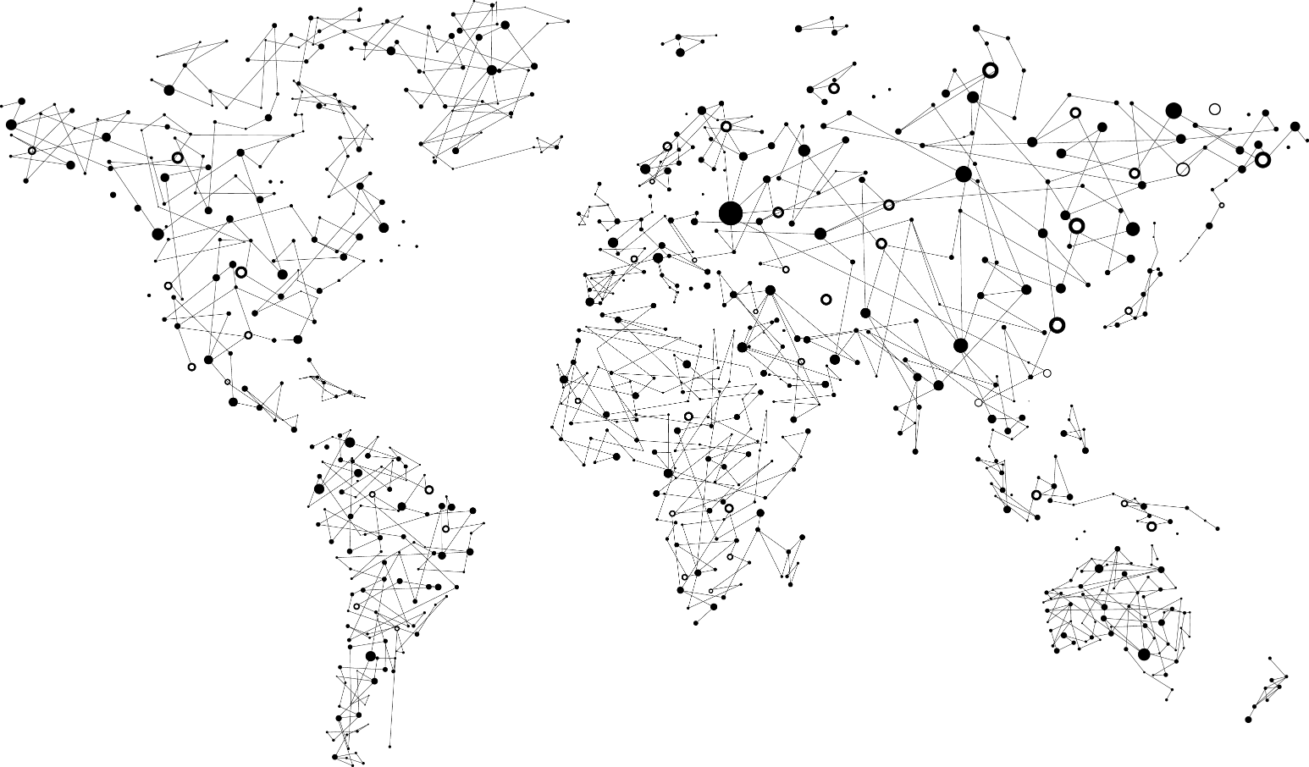
Achieve global scale, in local regions
Trust
38
Azure regions
RECENTLY LAUNCHED:
US Regions: West US 2 and West Central
Germany – Launched in Sep 2016
United Kingdom – Launched in Sep 2016
NEWLY ANNOUNCED:
France: France Central and France South
Korea: Korea Central and Korea South
DoD East and Central
Notes:
At the core of Azure is its global infrastructure that spans 38 regions worldwide. We have the largest footprint of any cloud provider.
https://azure.microsoft.com/en-us/regions/
https://azure.microsoft.com/en-us/regions/services/

Slide 15
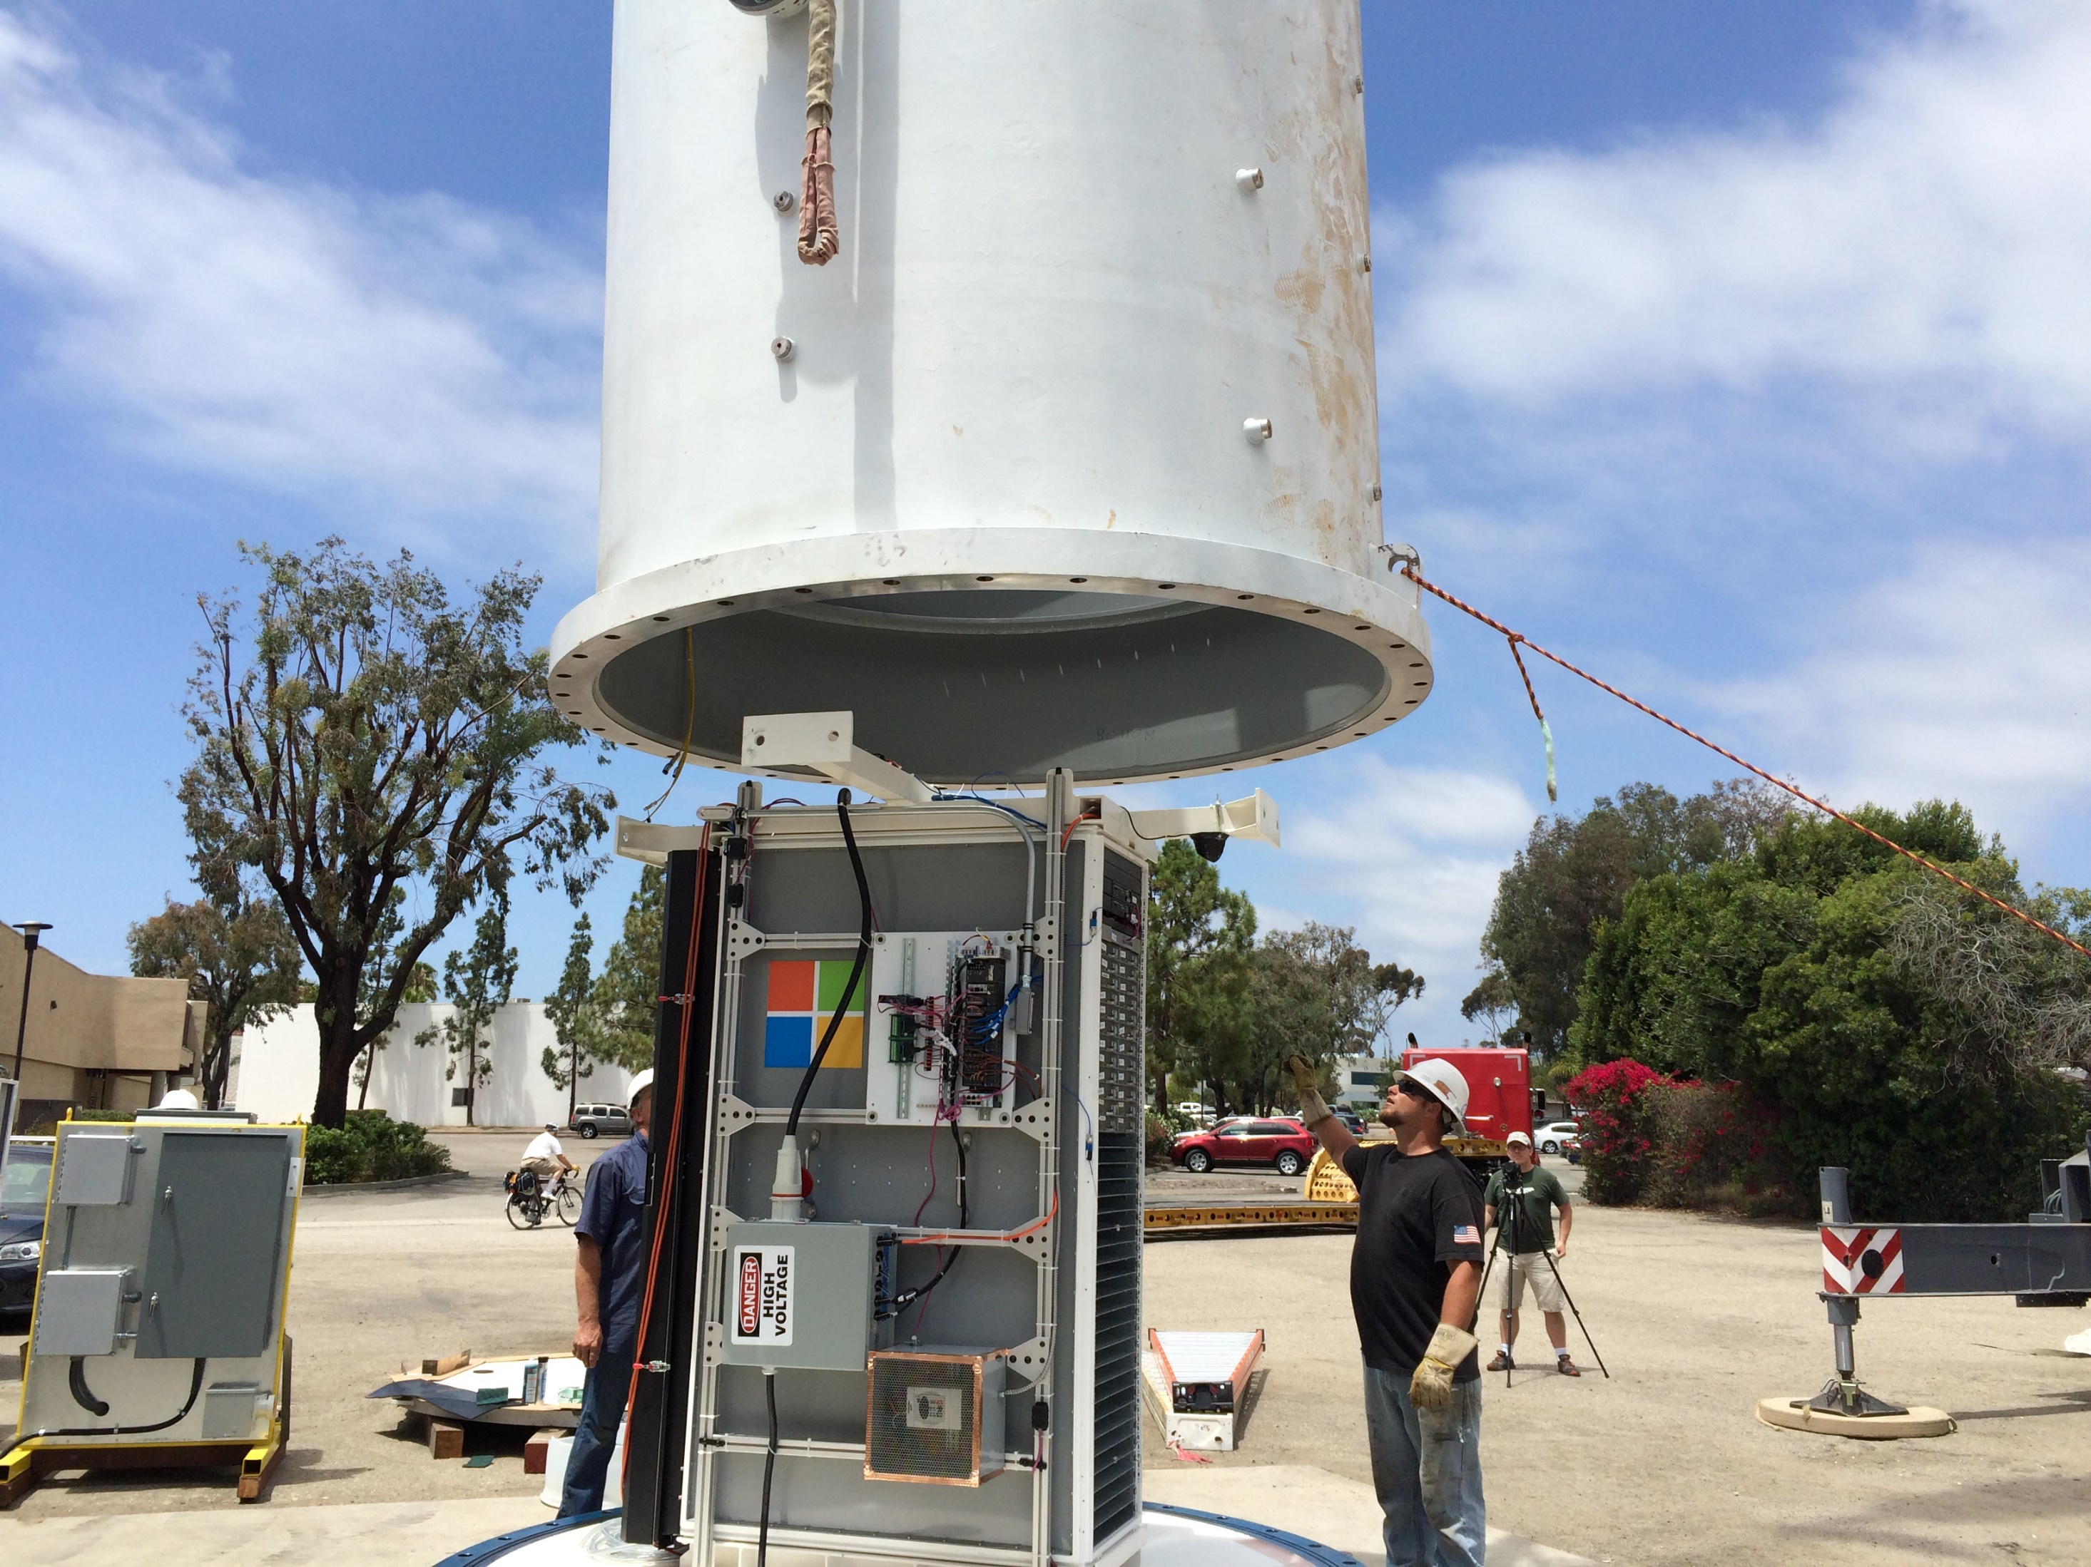
Notes:
My kids will probably hold a very different images of what a data center is. Microsoft Research is actively working on new approaches to bring resources online with more agility and proximity.

Slide 16
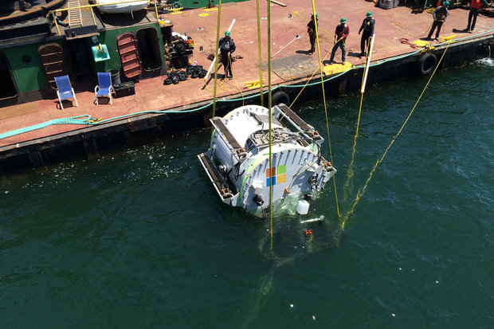
Notes:
Con’t

Slide 17
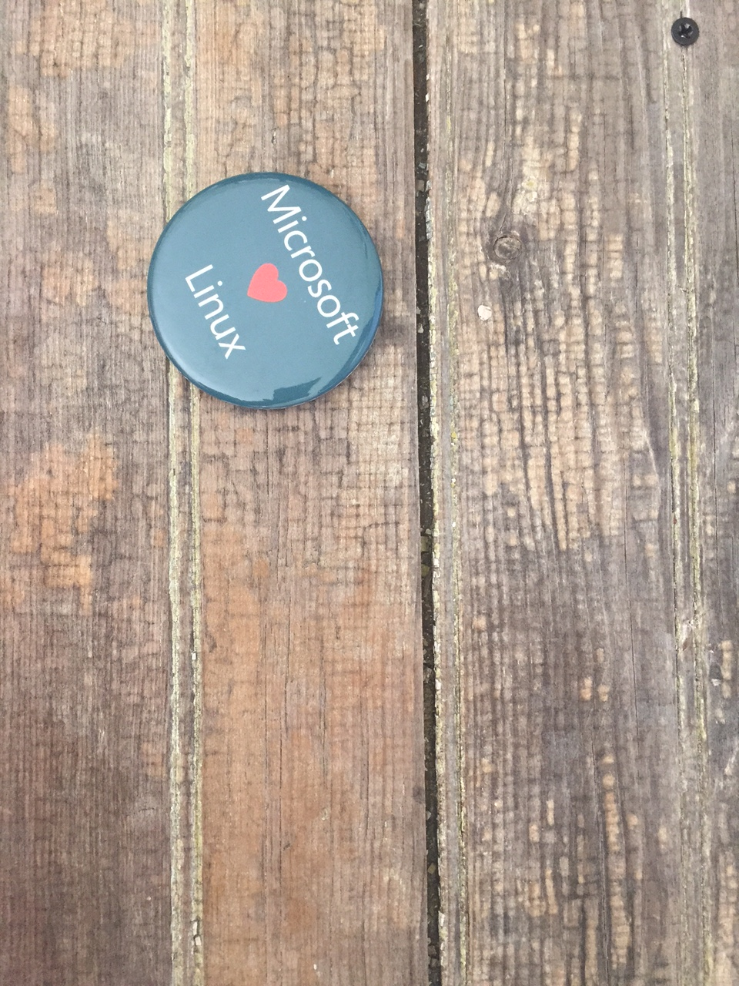
Notes:
Azure isn’t about Windows, its about enabling you to achieve more. Microsoft is undergoing a tremendous transformation and Linux/ Open Source Software is part of it. In a second we will dive in and I want you to remember that Microsoft is now the number contributor to OSS on GitHub and that some of the offered services are built and operated on Linux.
One of these services is the Azure SDN (Software Defined Network)
http://www.datacenterdynamics.com/content-tracks/servers-storage/microsoft-runs-azure-networking-on-linux/94837.fullarticle
Azure cloud uses Linux to handle data center networking - in a specialized software component developed by Microsoft to run conectivity within its cloud operating system, along lines set out by the Open Compute Project.

Slide 18
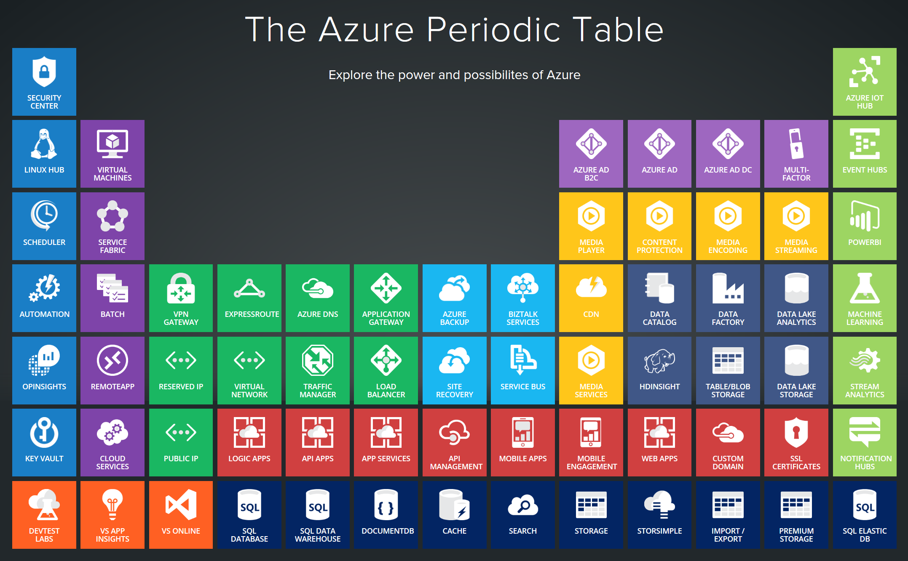
Notes:
Azure services support a multitude of scenarios from Infrastructure to platform services and extends your existing environments through various interconnectivity options. In today’s world, the level of sophistication required to innovate and compete requires us to be agile and adjust to a rapidly changing landscape. The cloud-only approach doesn’t work well for every scenario. Think about IoT and business critical workloads that drive delay sensitive manufacturing processes. Success comes from taking a hybrid approach and leveraging the cloud where it makes sense.

Slide 19
http://portal.azure.com
Notes:
Walk through the different sections, support tickets, azure market place, resource groups….

Slide 20
References:
Get started with Azure
Microsoft Azure Blog
Azure Updates
Cloud Platform roadmap
Azure Code Samples
Azure Quickstart Templates
AzureCAT Guidance
Cloud Design Patterns

